Slide 1
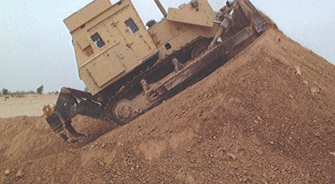
Bermzerk!
The Lost Cerritos Wetlands

Slide 2
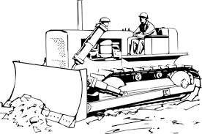
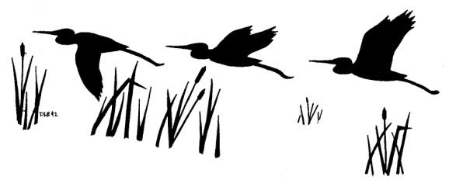
The Los Cerritos Wetlands Authority’s “optimized” Los Cerritos Wetlands Restoration Plan PEIR includes the construction of huge earthen berms across and around the wetlands to protect existing and proposed oil operations and industrial sites, and expanding commercial and residential developments from new tidal salt marshes and eventual sea level rise.

Slide 3
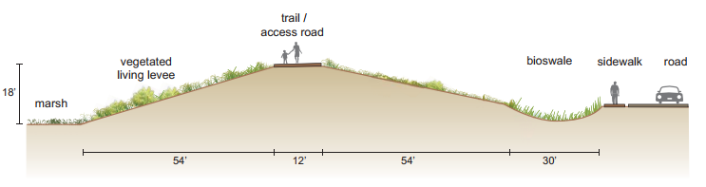
Some berms will be 18 feet tall
Some will be paved for vehicles servicing oil and gas operations
Some will have pump jacks sitting on top of them
Some will be set back to allow room for oil pipelines and runoff from streets
ALL BERMS WILL BE BUILT ON, AND ELIMINATE, EXISTING WETLANDS

Slide 4
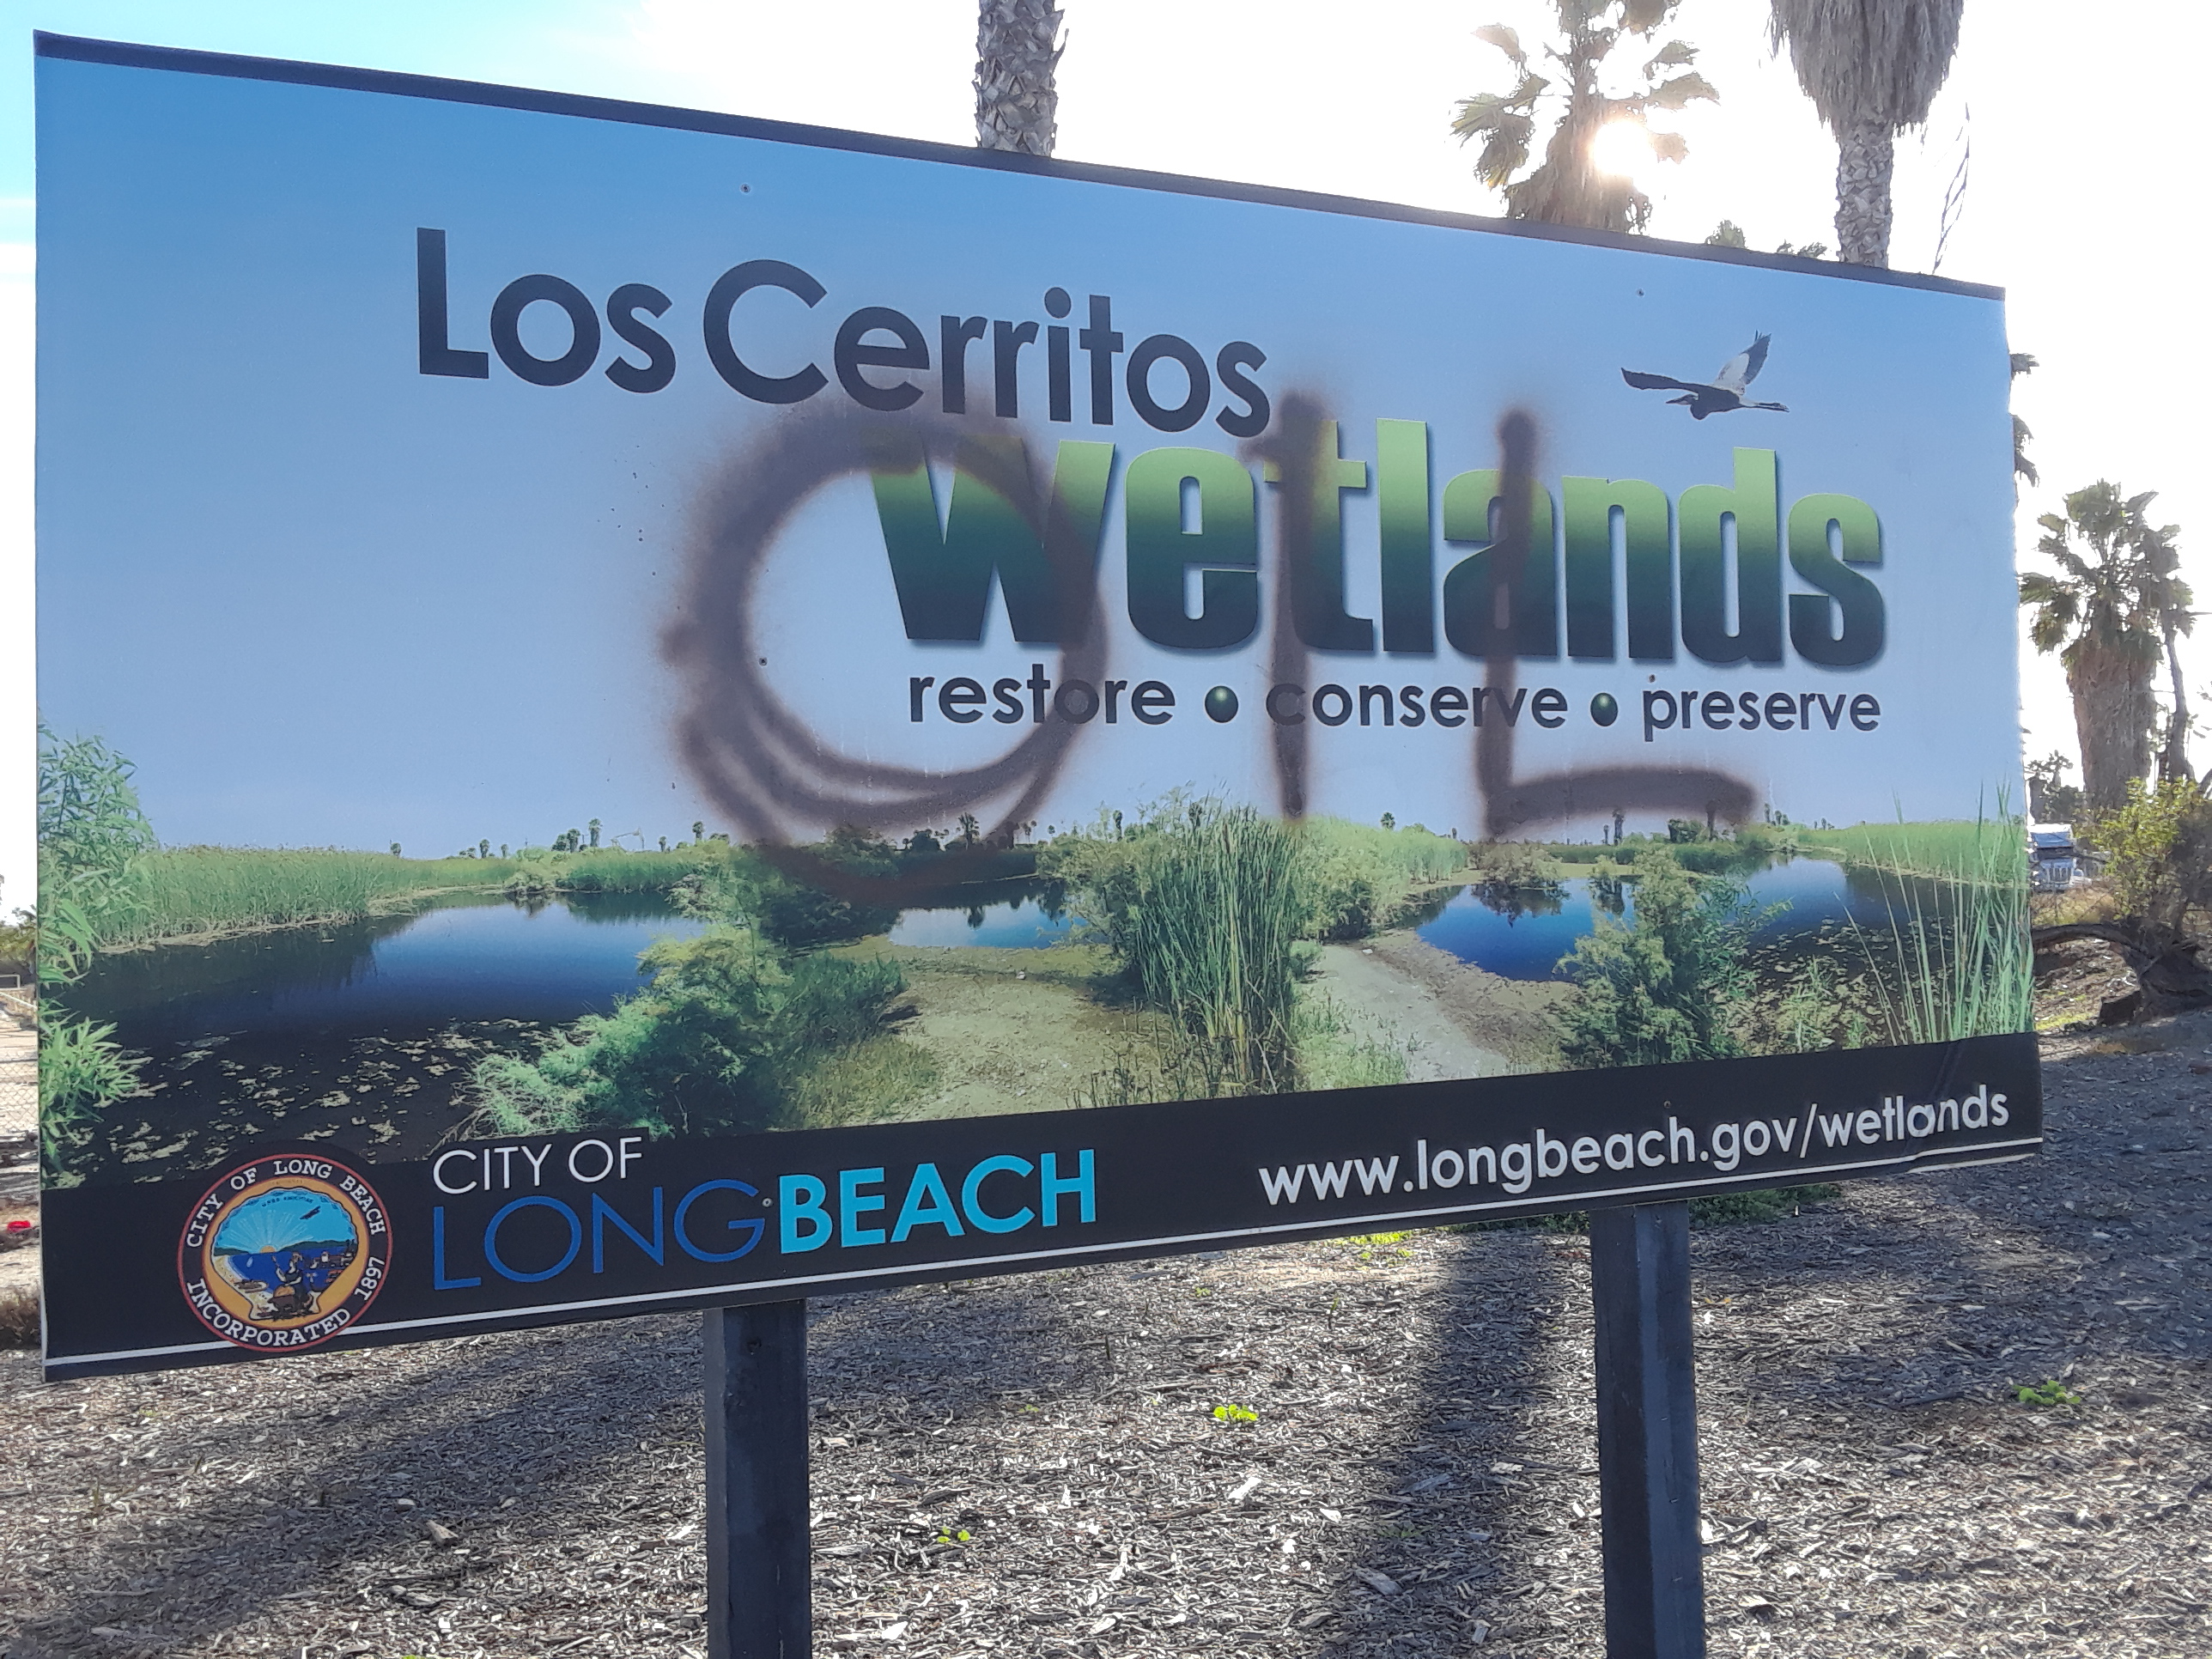
The addition of multiple berms, two visitor’s centers, parking lots, trails, oil pipelines, and raised roads to service oil wells will reduce wetlands acreage and connectivity, enlarging the human footprint at the expense of wildlife.

Slide 5
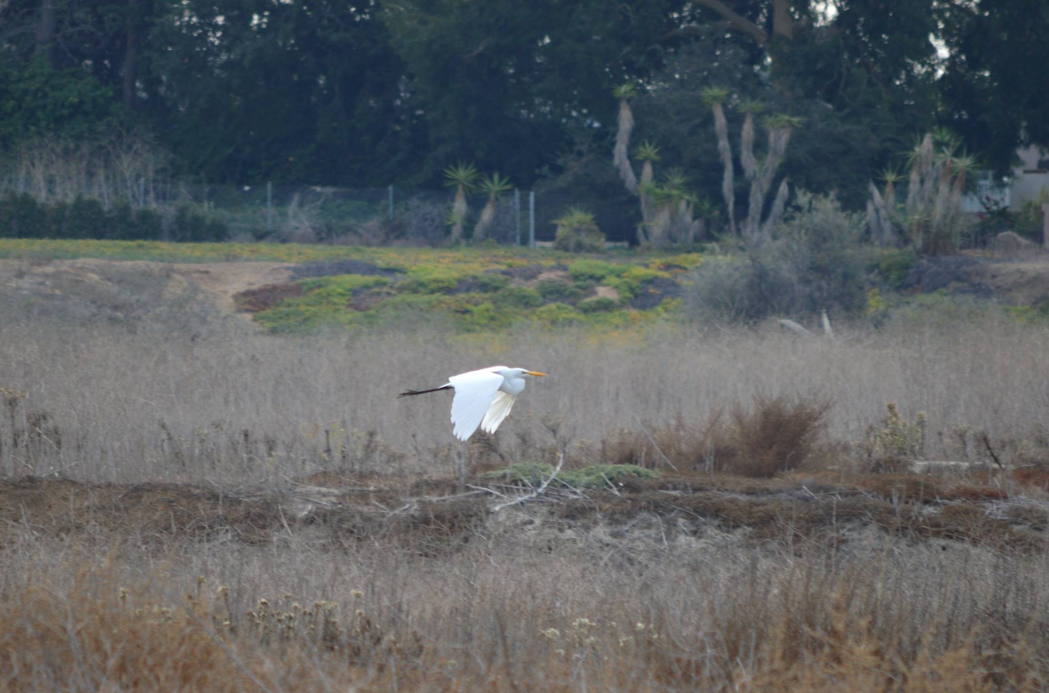
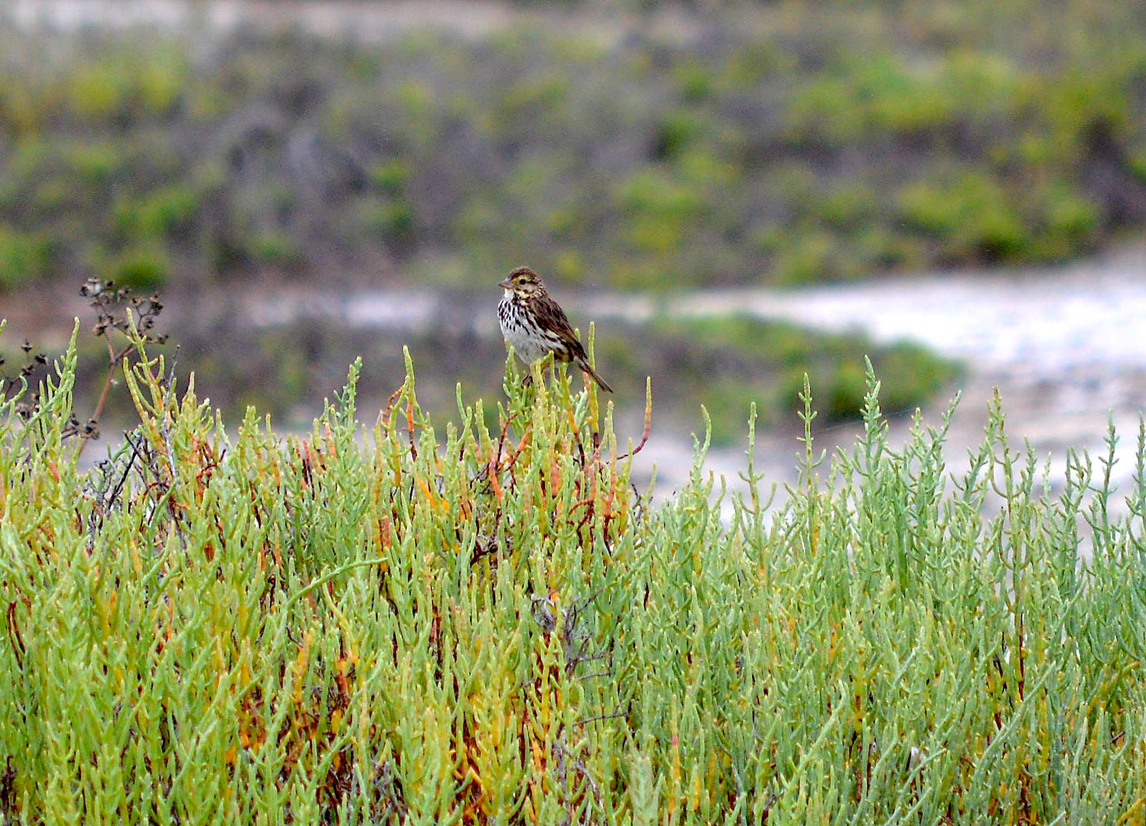
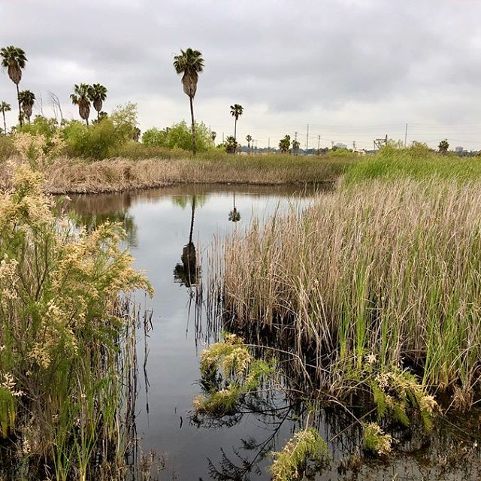
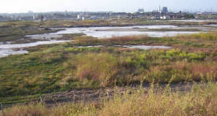
Existing wetlands habitat will be bulldozed, drowned, and buried as new salt marshes and flood control infrastructure are prioritized over the protection and preservation of wildlife habitat and a Tribal Traditional Landscape and Sacred Site.

Slide 6
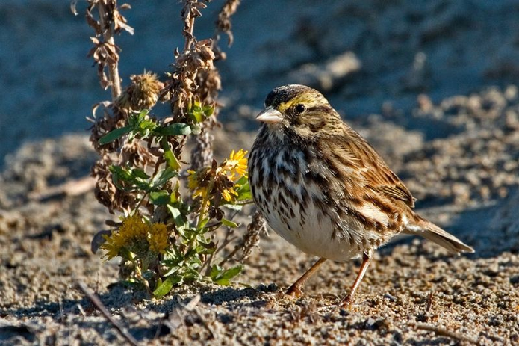
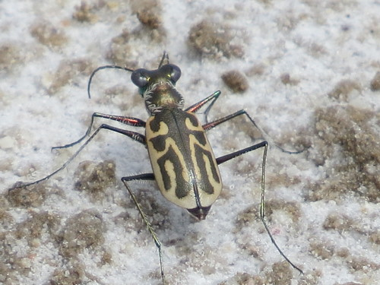
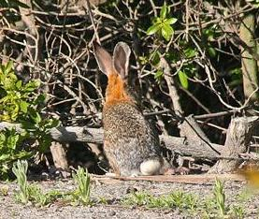
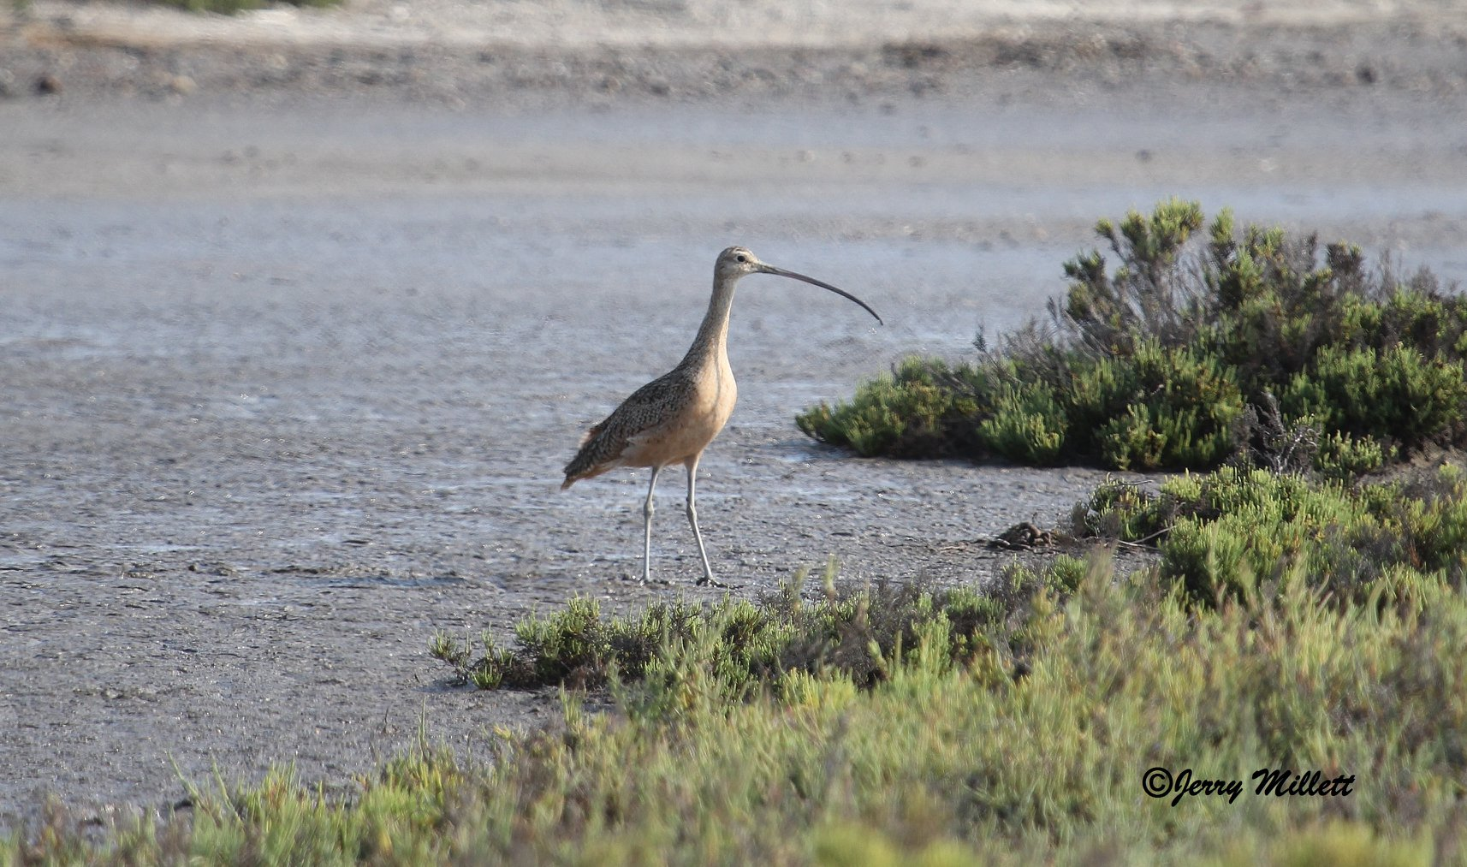
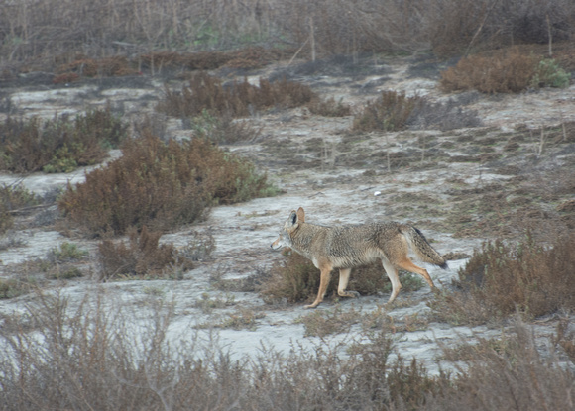
Flooding seasonal brackish wetlands and uplands to create a salt marsh monoculture is not restoration, but replacement. The Los Cerritos Wetlands are part of the estuary of the San Gabriel River and were never a full tidal salt marsh. All 10 acres of rare salt flats and most of the uplands will be lost, many residents will not survive the transition.

Slide 7
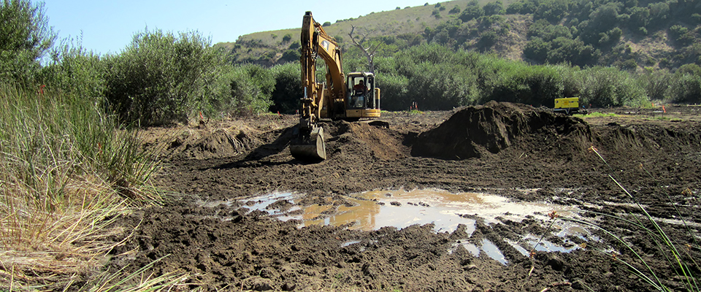
As new berms come and go, excavated and dredged soils will be stored on the wetlands until they are used in flood control or hauled away. The entire Los Cerritos Wetlands will become a construction zone for a half century or more.

Slide 8
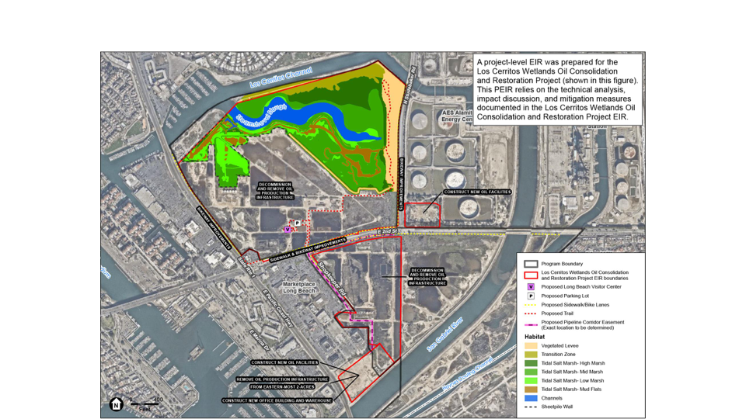

A sheetrock berm will protect Beach Oil Mineral’s existing oil field when the saltwater marsh is expanded, flooding seasonal wetlands and wildlife habitat. Old wells will continue to operate for twenty years after BOM expands onto two new nearby sites.
NORTH AREA
--------
---

Slide 9
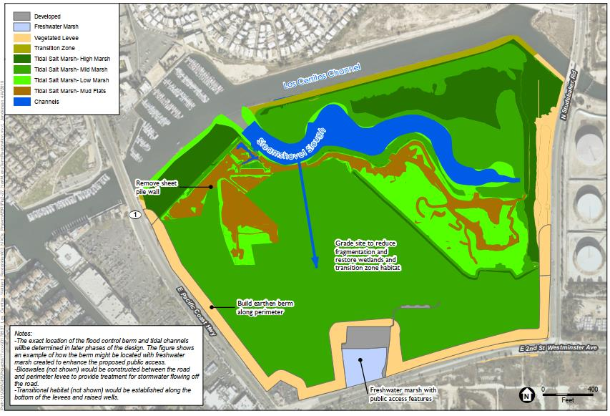
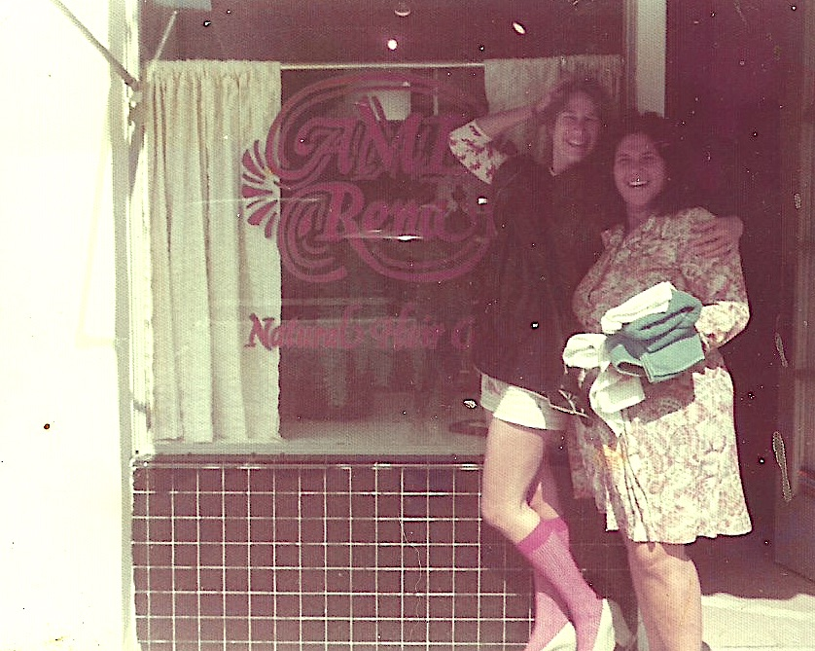

Eventually 18’ high berms will be built on existing wetlands along PCH, 2nd St, and Studebaker Rd. to protect the In and Out Burger, shopping malls, power plants, and 5 to 7 story mixed-use complexes on PCH between the San Gabriel River and Loynes Drive.
NORTH AREA
------------------
----------
------------

Slide 10
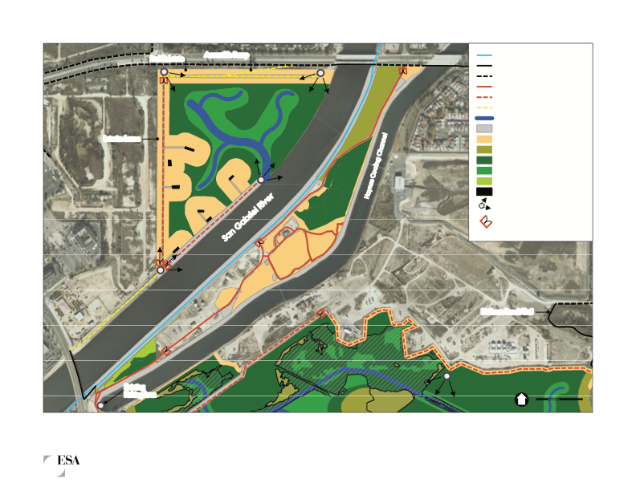
Signal Hill Petroleum’s wells on the wetlands will be lifted onto new berms also serving as service roads for well maintenance vehicles. A berm across the wetlands will also protect Synergy’s wells on the City of Long Beach property, and a berm on LCWA’s property along 2nd St will protect the industrial zone along the San Gabriel River.
------------
Oil wells and maintenance roads elevated onto berms
-----------
CENTRAL AREA

Slide 11
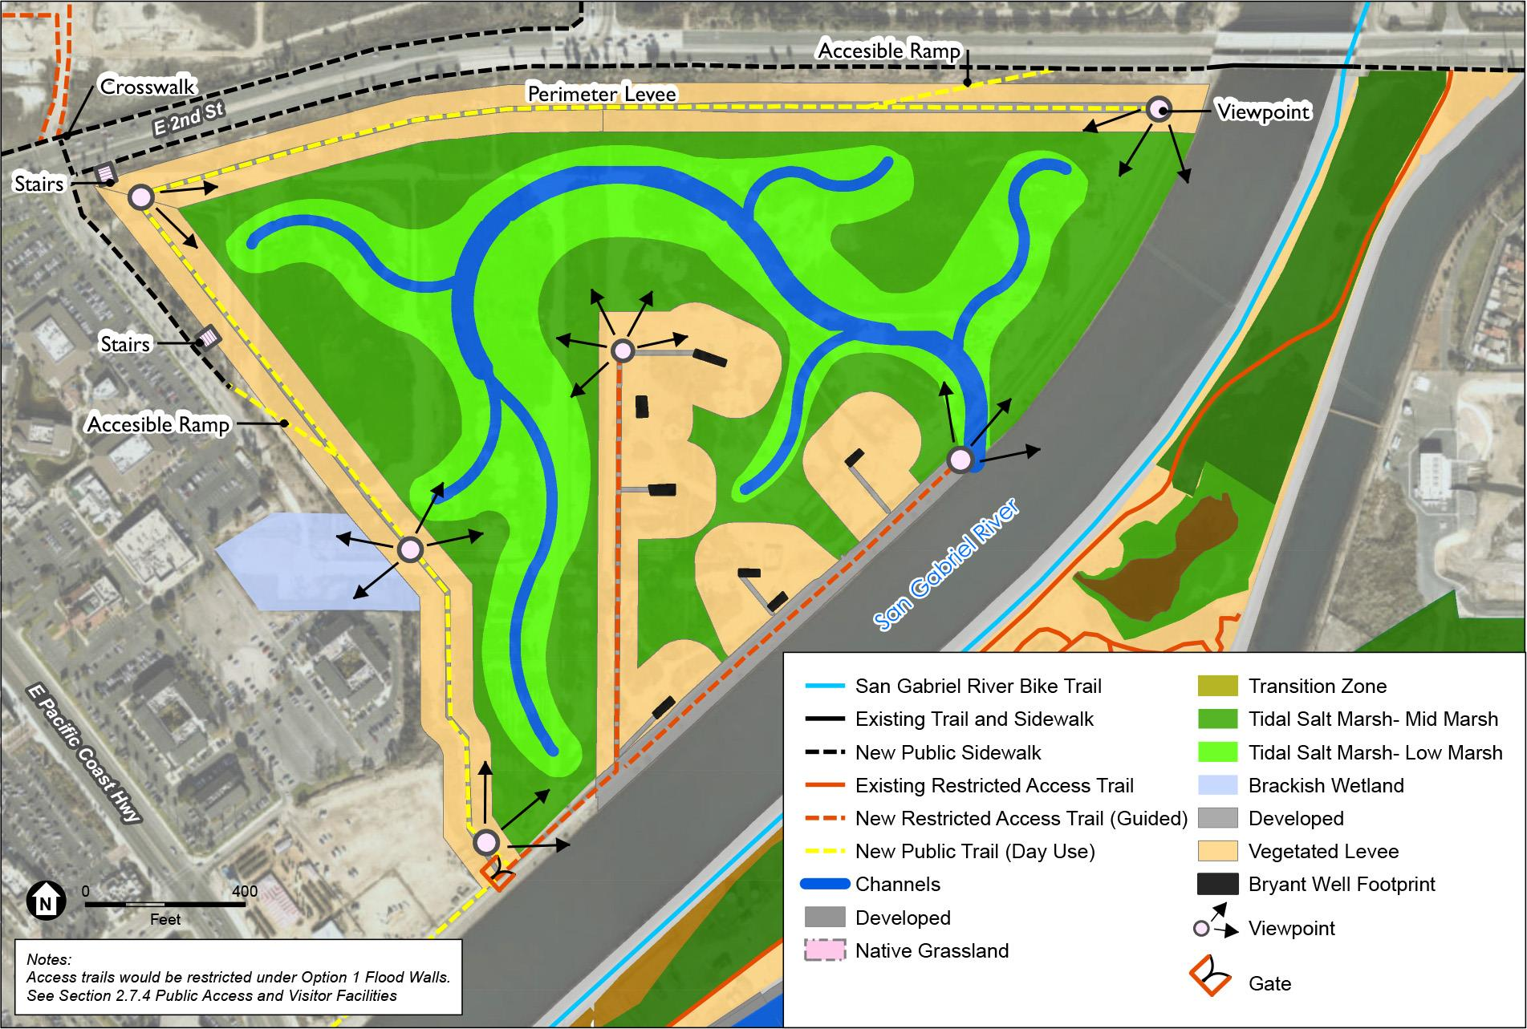
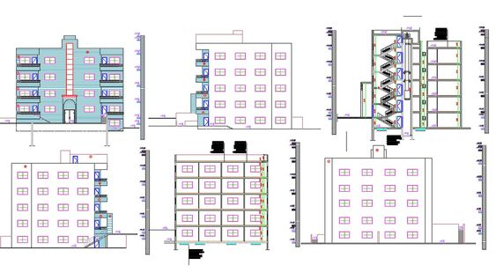
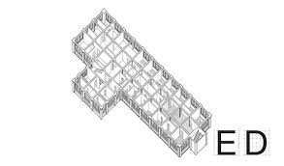
Berms on wetlands extending along 2nd St to PCH and along PCH to San Gabriel River serve as levees protecting new oil operations, malls, and 5 and 7 story mixed-use development. Remaining wetlands and wildlife areas are flooded to create salt marsh.
-------------
-------
---------
-
-------
----
Signal Hill Petroleum’s pump jacks remain on top of berms. Beach Oil Minerals’ new oil operations and office building are built on former Least Tern nesting site.
CENTRAL AREA

Slide 12
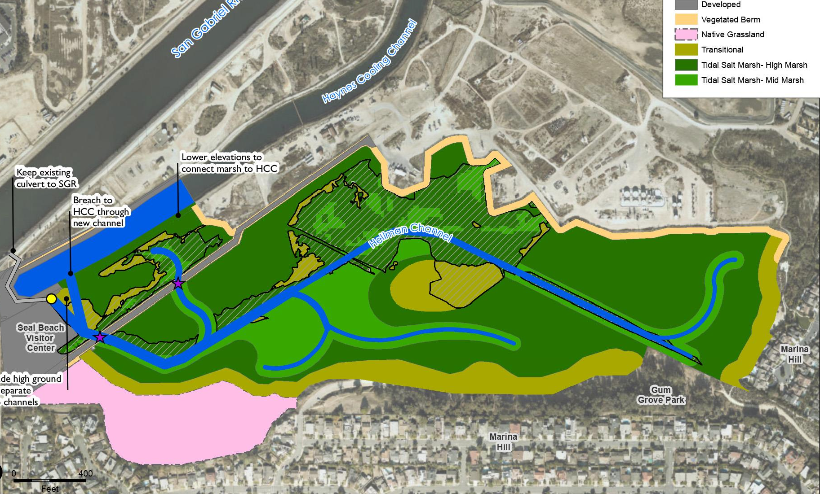
Berms will be built on existing wetlands and wildlife areas to elevate the service road to Hellman’s oil and gas operations and to protect well sites from flooding.
SOUTH AREA
------------
--------------

Slide 13
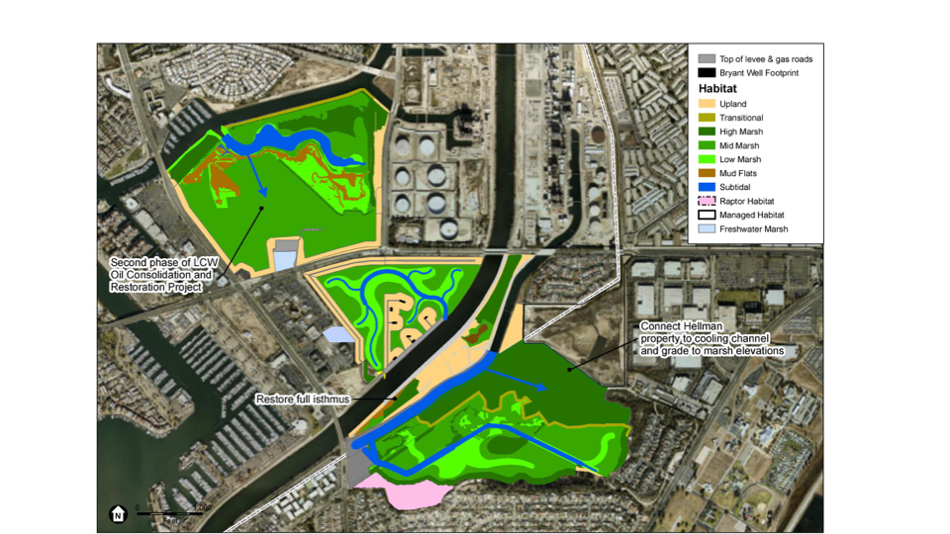
X = Cross out these 11+ new Berms! Adapting to sea rise and climate change should not come at the expense of existing wetlands and wildlife areas, nor should flood control measures designed to protect oil drilling operations and commercial properties be disguised as a wetlands restoration project. Wetlands, not Walls!
x
x
x
x
x
x
x
x
x
x

Slide 14


The LCWA’s approach to stewardship reveals a mindset of dominion over, rather than true appreciation for, the natural world and the original peoples of the land and must be rejected along with its proposed restoration plans and projects: The Los Cerritos Wetlands Restoration Plan PEIR The Southern Los Cerritos Wetlands Restoration Project The Upper Los Cerritos Wetlands Mitigation Bank The Los Cerritos Wetlands Restoration and Oil Consolidation Project The Land Swap between the LCWA and Beach Oil Minerals No public funds should be authorized for any of the above, including a $250,000 grant to the LCWA for plans and permits currently under consideration by the California Coastal Conservancy.

Slide 15
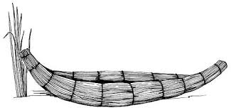
How You Can Help Influence Decision Makers Tell the LCWA not to approve the Los Cerritos Wetlands Restoration Plan PEIR, new salt marshes, or berms. Contact Wade Crowfoot, State Secretary of Natural Resources, and Governor Newsom and ask them to oppose the PEIR as it is not restoration but a plan to erase and replace natural and tribal resources while promoting expanded oil drilling, commercial, and residential development. Connect and Participate Learn about past and present efforts to protect the Los Cerritos Wetlands, contact organizers, and get details and updates at Protect the Long Beach/Los Cerritos Wetlands on Facebook. Join actions and speak up at meetings of local and state agencies, mostly held on Zoom these days Spread the Word Share info with friends, community groups, tribal, environmental, and racial justice organizations. Plan events opposing the LCWA’s plans and supporting wetlands and water protectors. Contact local and tribal media, write letters to the editor and ask reporters to cover the issue. Support Fundraising Donate to the lawsuit filed by Puvungna Wetlands Protectors against the California Coastal Commission for their 2018 decision to override the Coastal Act and approve the Los Cerritos Wetlands Restoration and Oil Consolidation Project. Email achris259@yahoo.com

